Slide 1
6120 Final Project
Group 22
Min Zhou
Tianyu Gao
Zhen You

Slide 2
Project Definition
Objectives：
Design and setup database with the provided data.
Create a Java application with GUI that is capable of interacting with the database.
Correctly Implement the queries in SQL.
Performance：
Show the query result in GUI
Show the table in GUI

Slide 3
P
F
F
The E-R model
SupplierID
ContactLastName
ContactFirstName
SubjectID
SupplierID
Title
Author
UnitPrice
P
BookID
Quantity
CompanyName
Phone
Book
Supplier
F
F
1
OrderID
BookID
Quantity
N
N
Supplies
Type-OF
Order_Detail
1
1
N
Order_Item
Subject
N
F
F
Content
CustomerID
EmployeeID
ShippedDate
P
Content
SubjectID
Category Names
P
F
1
OrderID
ShipperID
OrderDate
Order
N
N
Ships
Orders
N
Handles
1
1
1
Shipper
Customer
Employee
P
P
P
ShipperID
ShipperName
CustomerID
FirstName
LastName
Phone
EmployeeID
FirstName
LasrName

Slide 4
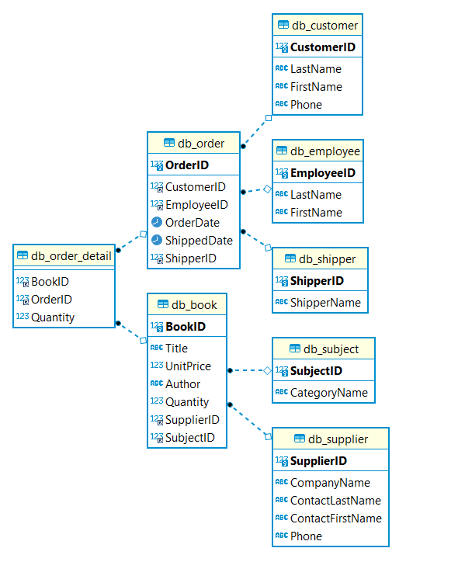
Relational Schema

Slide 5
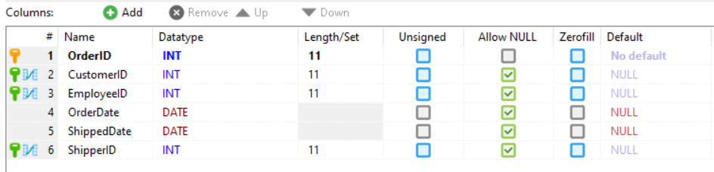
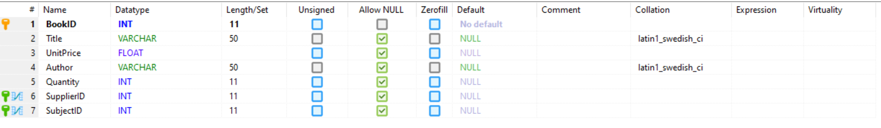
Tables | Primary Key | Foreign Key
db_book | BookID | SupplierID, SubjectID
db_order | OrderID | CustomerID, EmployeeID, ShipperID
db_supplier | SupplierID
db_customer | CustomerID
db_employee | EmployeeID
db_order_detail |  | BookID, OrderID
db_subject | SubjectID
db_shipper | ShipperID
Key and Database

Slide 6
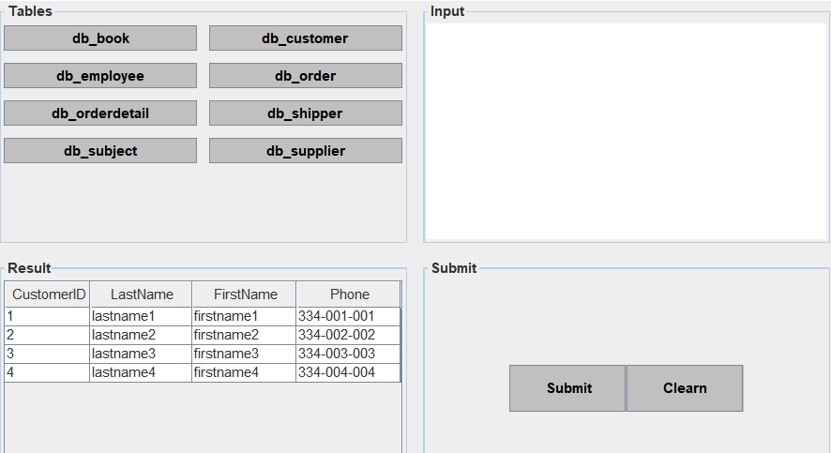
Java Application with GUI

Slide 7
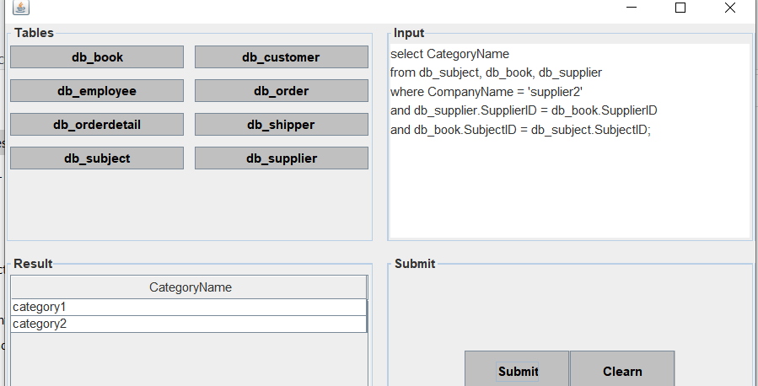
Demo-Query examples

Slide 8
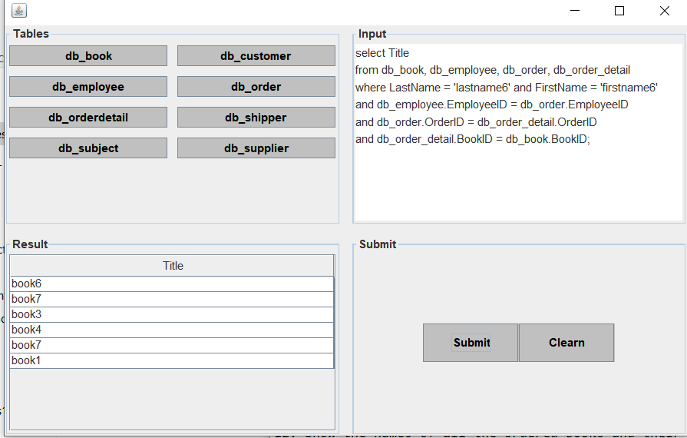
Demo-Query examples

Slide 9
End
Thank you

